Slide 1
Roles of Computer Technology
Student’s Name
Institutional Affiliation
Date of Submission

Slide 2
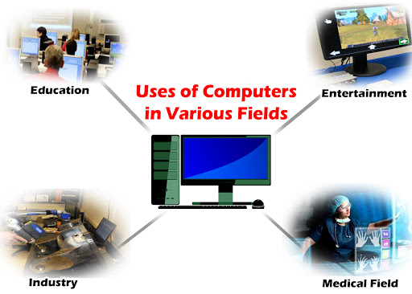

Slide 3
Introductions
Computer technology, which involves creation of software and hardware for computers so as to perform several tasks that would otherwise be impossible for a person to undertake, have found its way in several fields.
Students, healthcare workers as well as business personnel have embraced this idea in diverse ways.
Computer technology has therefore played crucial roles to enable the success of individuals in these field.

Slide 4
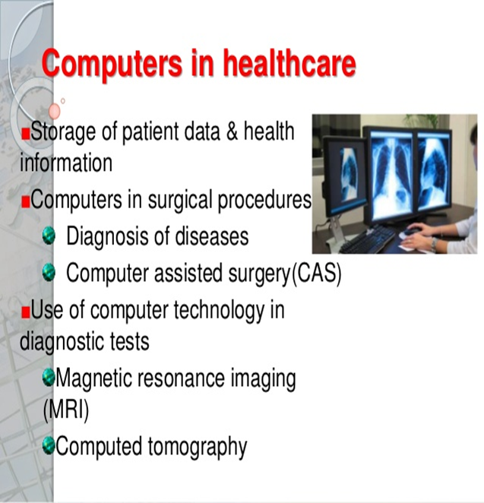
Healthcare Professionals
Through computers, human errors in the field of medicine as well as communication has been managed greatly.
In an article by Patrick (2019), the author purported that medication and treatment has greatly been improved by the use of computers

Slide 5
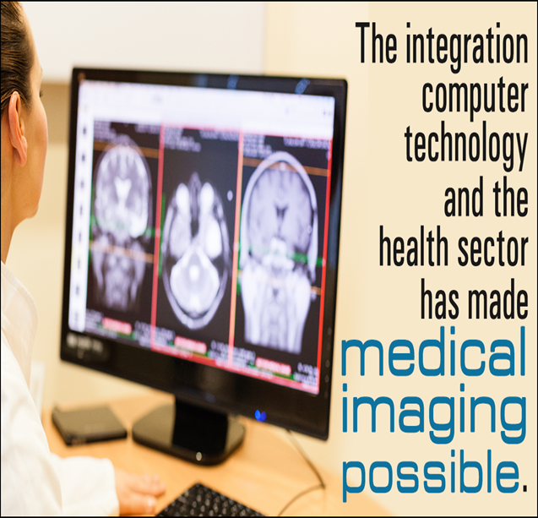
Healthcare Professionals
Data keeping of the patience have been improved.
complex operations such as patient diagnosis, surgery and medical imaging such as mammography, ultrasonography, magnetic resonance imaging x-rays are carried out electronically
Patrick (2019) further tells that, computers are now being used to conduct researches and lab tests which are then shared between medics and patients.

Slide 6

Education
With the onset of distance learning which takes the form of online learning or e-learning, students are currently taking up classes, assignments, and even exams behind the screens of their laptops without necessarily attending physical classes
Through the storage of books and information in the form of e-books and the emerging online library, students can conduct research comfortably with vast data and be able to write a good thesis

Slide 7
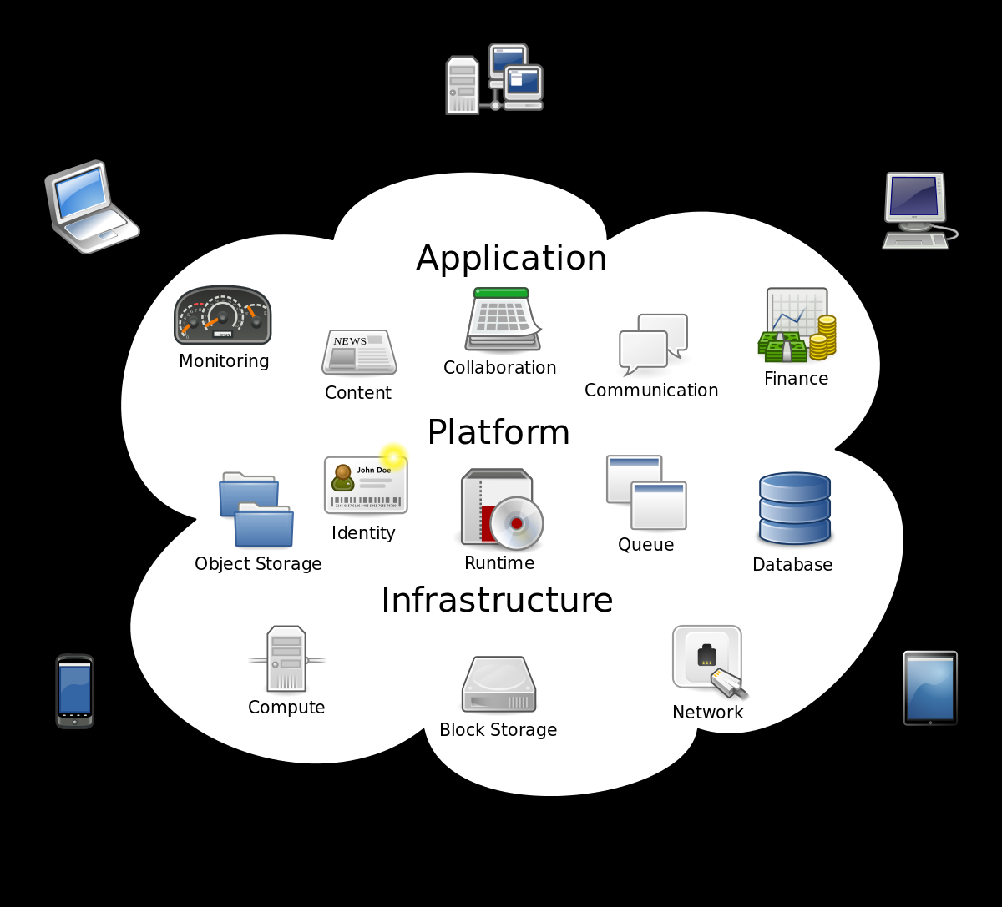
Corporate Business World

Slide 8
Corporate Business World
Corporates are currently dependent on new technology in the quest to be able to remain competitive in the market by improving marketing, strategy, and production at large
Communication is enhanced through tools such as emailing and production, on the other hand, is heisted by computer-operated machines.
Through the storage of information on computer systems, large companies can operate with many branches and still have no problem with aspects such as accounting and auditing.

Slide 9

Corporate Business World
Businesses are also using computer technology in analyzing strategically data before making decisions, such include demographic analysis, product design, market complexity, and many more.

Slide 10
Conclusion
In conclusion, the role of computer technology in various fields is clear and still inevitable. Students, healthcare workers as well as businesses have relied on computer technology in several ways to better their performances. It is a path that other professions have to follow to remain relevant and competitive.

Slide 11
References
Baylor, University of. “What Is the Role of Technology in Business? | Baylor Online.” Baylor University MBA Online Degree Program, 9 Feb. 2016, onlinemasters.baylor.edu/articles/what-is-the-role-of-technology-in-business.aspx.
Patrick. “6 Common Uses for Computers in Healthcare.” Scott-Clark Medical, 5 Jan. 2019, www.scott-clark.com/blog/6-common-uses-for-computers-in-healthcare/.
Wantok, Tyler. “How Important Is Technology in Education? Pine Cove’s Top 10 Reasons.” Pinecc.Com, 2015, marketing.pinecc.com/blog/the-importance-of-technology-in-education-pine-coves-top-10-reasons.

